Slide 1
k-Nearest Neighbor Classifier
Srikanth Gunturu
Guest Faculty
BITS, WILP

Slide 2
In this segment
k-Nearest Neighbor Classifier
Nearest Neighbor – Overview
kNN classifier – Introduction
kNN classifier – example
Variations with k

Slide 3
k-Nearest Neighbor Classifier
Instance based learning – Nearest Neighbor Classifiers
Nearest Neighbour classifier is an instance based classifier, in contrast to generative models
Also called ‘lazy learning’, as learning is postponed until a new instance is encountered
Constructs a local approximation to the target function, applicable (better suited) in the neighbourhood of new instance
Suitable in cases where target function is complex over the entire input space, but easily describable in local approximations
Real world applications found in case based learnings, like help desk, legal cases etc.
Caveat is the high cost of classification, which happens at the time of processing rather than before hand (there’s no training phase)

Slide 4
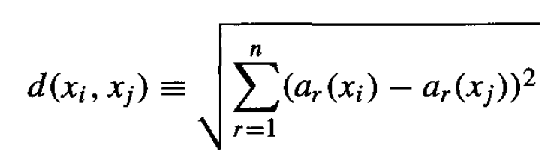
k-Nearest Neighbor Classifier
kNN Classifier - Introduction
Considers all instances as members of n-dimensional space
Nearest neighbours of an instance is determined based on Euclidean distance
Distance between two n-dimensional instances x_{i} and x_{j} is given by:
For NN classifier, target function can be discrete or continuous

Slide 5
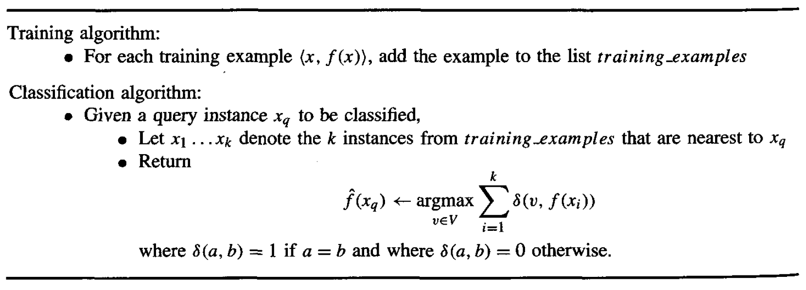
k-Nearest Neighbor Classifier
kNN Classifier - Algorithm

Slide 6
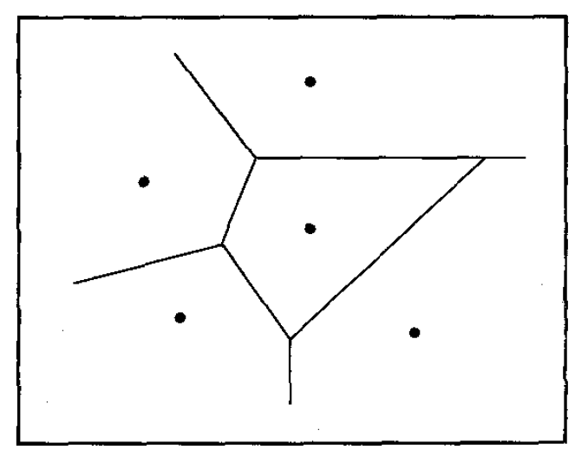
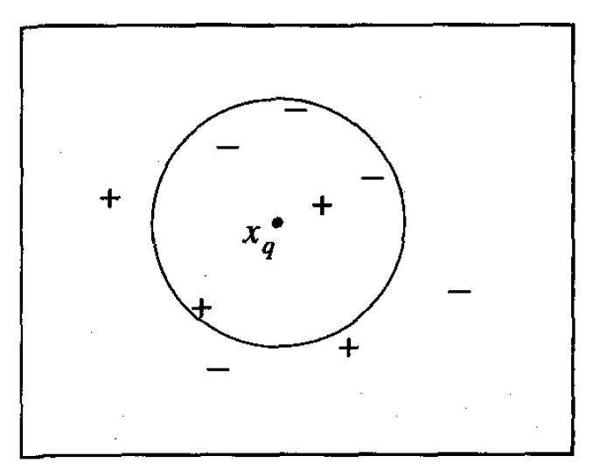
k-Nearest Neighbor Classifier
kNN Classifier – Example(s)
K=1
K=5

Slide 7
k-Nearest Neighbor Classifier
kNN Classifier – Working example

Slide 8
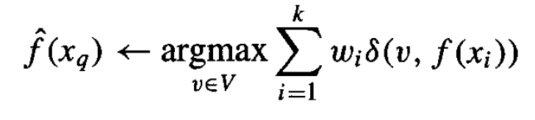
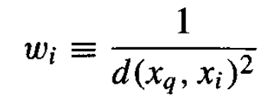
k-Nearest Neighbor Classifier
kNN Classifier - Distance weighed
This refinement adds a ”weight” factor to kNN algorithm
Weight would be based on the distance (ex: inverse square of distance from query instance), which gives more weightage to the closer neighbours
Modified function would be: where
This method is robust to noisy training data and effective for large set of training data
Con for kNN is the well-known “curse of dimensionality”
Can be overcome by weighing each attribute differently while calculating distances or eliminating irrelevant attributes

Slide 9
Thank You!
In our next session:
Measures of prediction accuracies of classifiers

